Slide 1
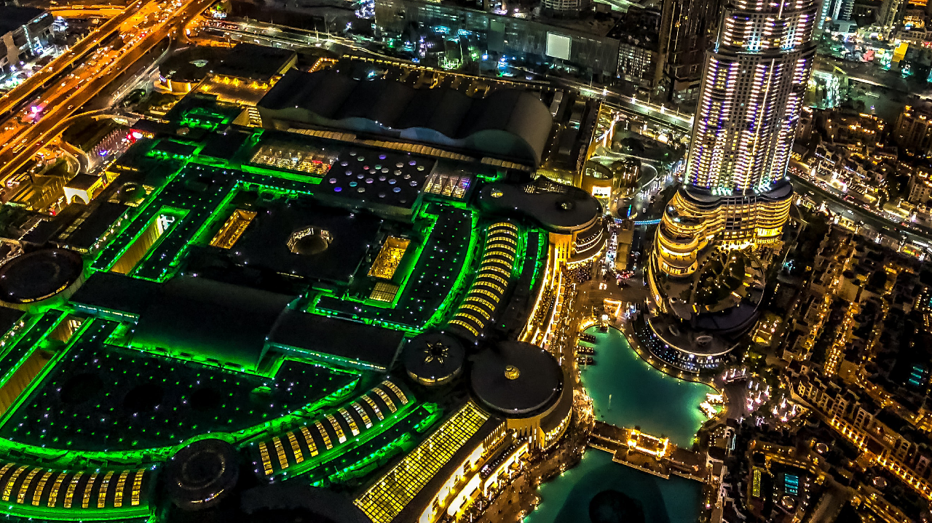
Healthy Planet, Healthy People: Why nature holds the key to the future
Professor Paul Ekins OBE
Professor of Resources and Environmental Policy and Director
UCL Institute for Sustainable Resources, University College London

Slide 2
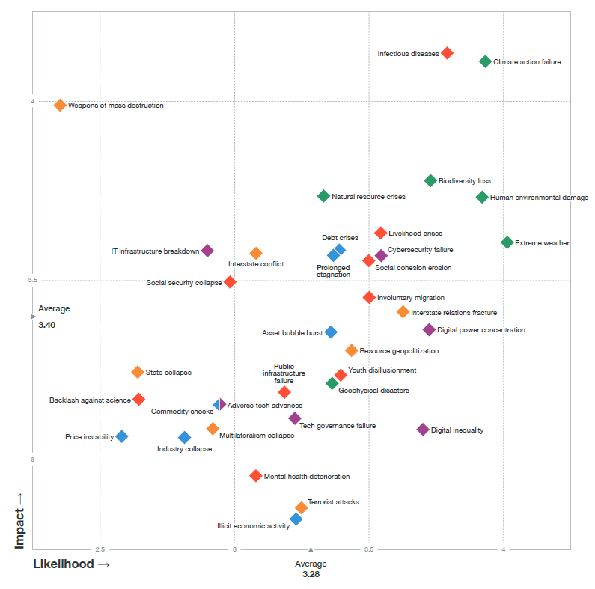
Perceived global risks are now predominantly environmental Source: WEF Global Risks Report 2021

Slide 3
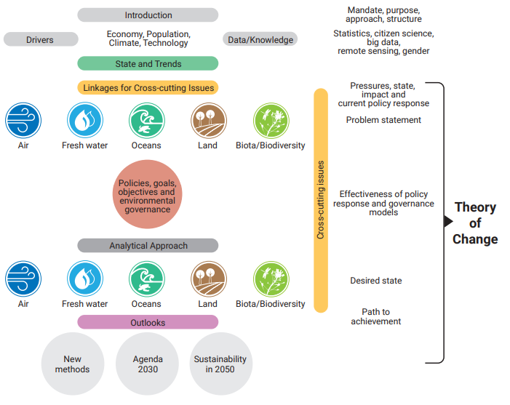
GEO-6: UNEP’S Global Environment Outlook

Slide 4
Drivers and cross-cutting issues
Population - 9-10 billion people by 2050
Demographics - older in rich countries, younger in poor countries
Urbanization - 6-7 billion living in cities by 2050, 2-3 billion of those living in informal settlements
Economic development – needed to eradicate poverty, end hunger, but increases consumption and extraction of resources
Technological change – positive (productivity increase) and negative (pollution, waste)
Climate change – already a 1 degree Celsius increase. We are committed to increases in sea-level rise, more frequent droughts, more severe weather events.
Cross-cutting issues – human health, equity, environmental disasters, chemicals, energy, waste and wastewater, gender, education, polar/mountain regions, food/energy/resources

Slide 5
Impacts from human activities
Pervasive unsustainable impacts across all five environmental dimensions explored in GEO-6: air, land, freshwater, oceans and biodiversity
Human health – 9 million premature deaths due to environmental pollution in 2015. Mainly indoor and outdoor air pollution, but also water pollution and sanitation. 60% of all emerging infectious diseases in humans are zoonotic, increasing the risk of pandemics.
Environmental disasters – Affected more than 3 billion people between 2005 and 2015
Energy –1.2 billion people don’t have access to electricity and 2.7 billion still use traditional fuels for cooking and heating.
Chemicals – More than 100,000 chemicals in use. Chemical pollution now a global threat.
Waste and wastewater – urban waste generation is about 7-10 billion tons/yr, much of it unmanaged.
Notes:
Learning objectives: the audience will understand that several other activities and sectors affect the environment or are effected by environmental degradation.
Proposed speaking points:
It is important to put the environmental issues we are speaking about within the context of the activities and sectors which affect the environment or are impacted by environmental degradation. It is in these sectors where policy actions can be taken that will have a more transformational approach.
One of the main focus areas of this Global Environment Outlook has been the link between environmental degradation and human health. Health is impacted by the environment and there are also environmental impacts from the health sector (e.g. antibiotics and antimicrobials).
The report finds that 9 million premature deaths were due to environmental pollution in 2015. This is a combination of indoor and outdoor air pollution (6-7 million deaths) and pollution in freshwater and sanitation systems. Moreover, the World Health Organization has found that 23 per cent of global deaths in 2012 were from modifiable environmental health risks. This significant link to the health Sustainable Development Goals means that important co-benefits could be realized through integrated policy approaches on environment and health.
Both slow-onset and sudden-onset environmental disasters can affect human health and security. Between 2005 and 2015 3 billion people worldwide were affected by these types of environmental disasters. Mitigating these disasters or building resilience can be useful strategies for these environmental and social consequences.
Although our energy systems cause significant environmental degradation (e.g. climate change, air pollution), there are also important social and economic benefits from access to modern energy services. Globally 1.2 billion people don’t have access to electricity and 2.7 billion people still use traditional fuels (e.g. wood, charcoal, dung) for cooking and heating. Strategies to improve the quality of life of families, eliminate poverty and leave no one behind will likely need to consider how energy systems need to be modified in different parts of the world.
We are living in the most chemical-intensive period in human history. More than 100,000 chemicals (including pharmaceuticals) are in use worldwide and global strategies for managing these chemicals are not being implemented fast enough to keep pace with the environmental and human health impacts that they create.
Our ‘grow now – clean up later’ society is generating more and more waste and wastewater. Currently 7-10 billion tons of solid waste is generated each year and most of it is poorly managed. Significant opportunities exist to re-use or recycle this waste, which could lead to reduced environmental and health impacts.

Slide 6
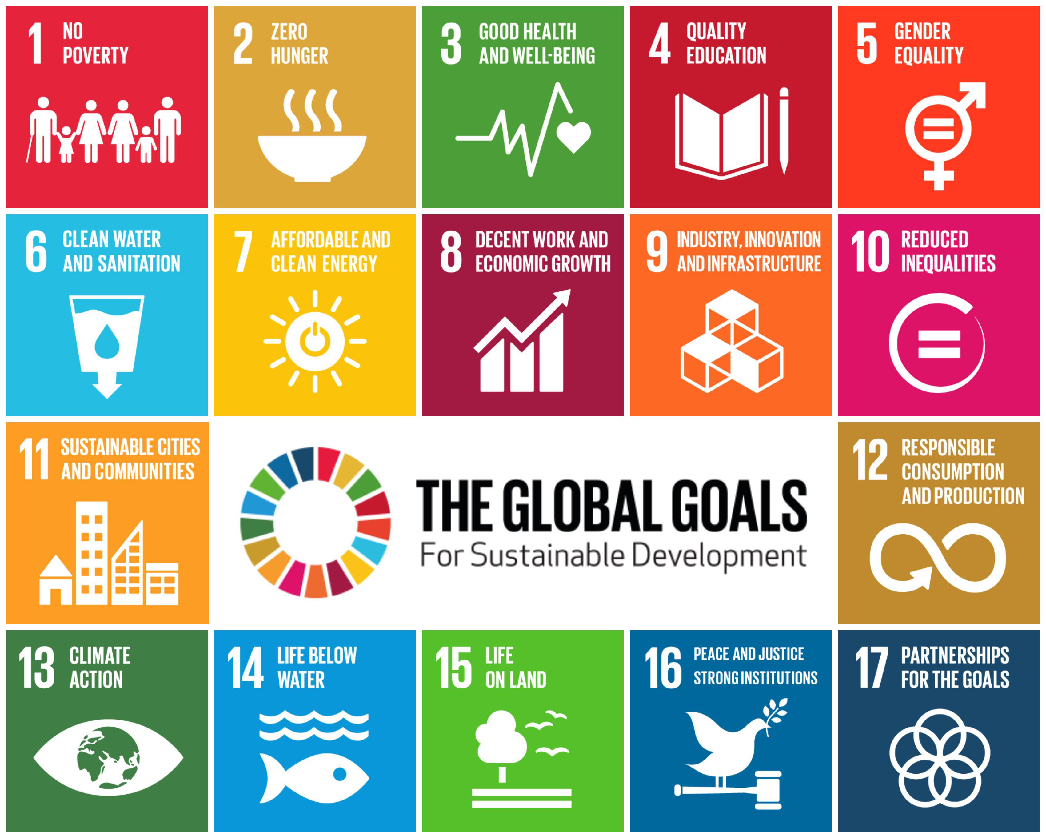
UN Sustainable Development Goals (SDGs)
For each SDG there is a number of Targets (169), and Indicators (232) which show the extent to which the target is being achieved

Slide 7
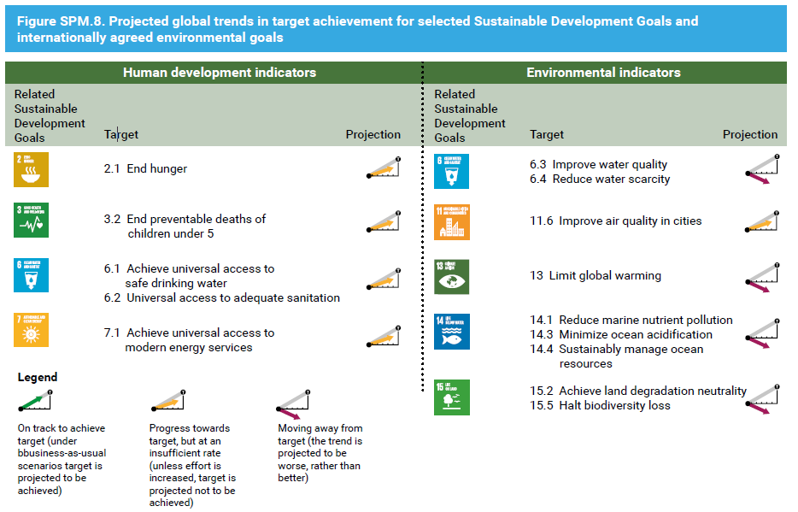
GEO-6: Outlook for the future (1)

Slide 8
GEO-6: Outlook for the future (2)
Environmental dimension of SDGs and IAEGs – not expected to be achieved under current policy scenarios.
All environmental areas are affected – from climate change to biodiversity loss to water scarcity, land degradation and ocean acidification.
Urgent action needed – failure to act now will lead to ongoing and irreversible impacts on the environment and human health.
Decarbonisation, detoxification, dematerialisation – key priorities for development.
Costs – It often costs more to clean up later than to prevent damage now, but ‘grow now, clean up later’ mindset still predominates.

Slide 9
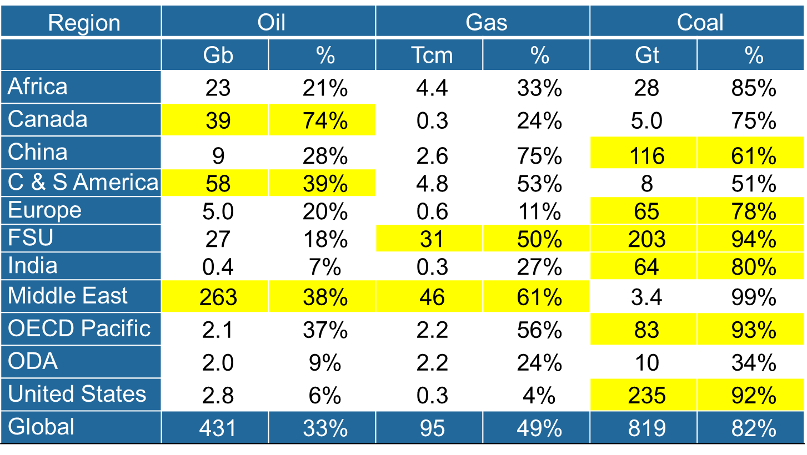
Regional distribution of reserves unburnable before 2050
to stay below 2ºC

Slide 10
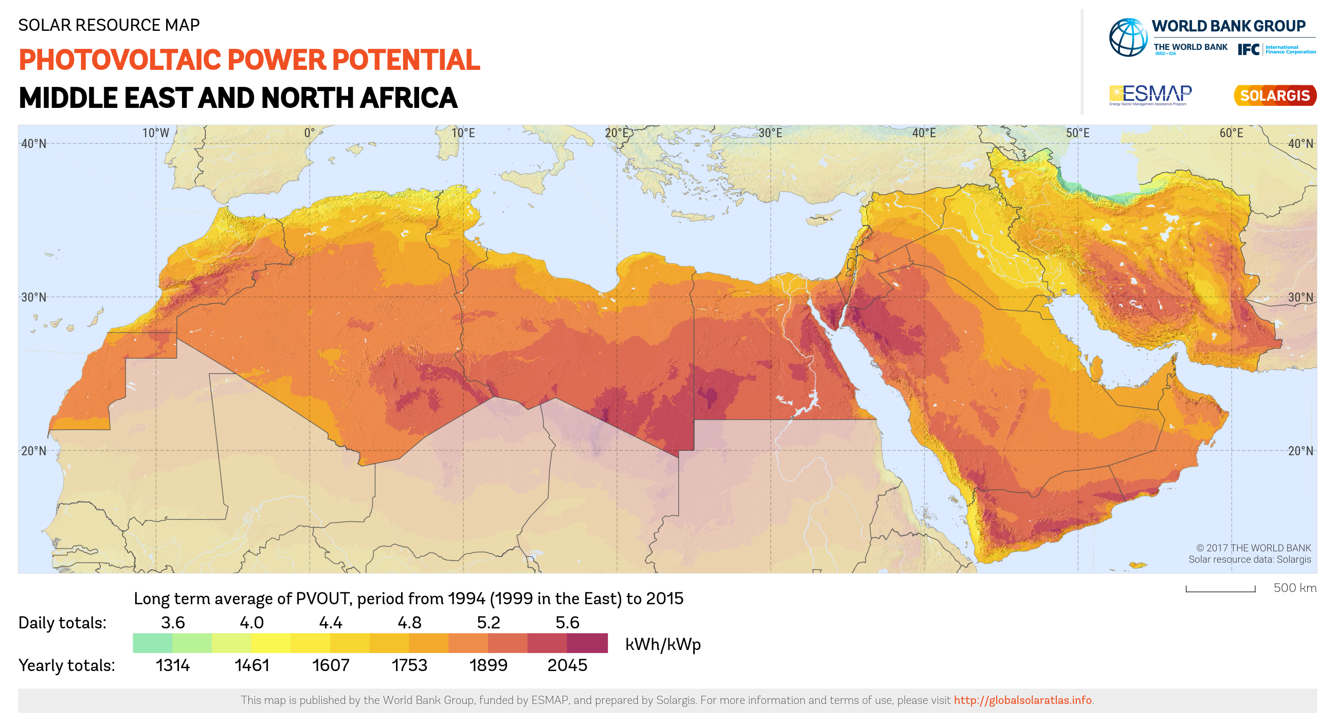
What is the future for MENA with decarbonisation?
The imperative of economic diversification
Education, education, education
Innovation and business development
The opportunity of solar energy
Huge resource
Cost reductions
New technologies: solar electricity and green hydrogen (investment in batteries and electrolysers)

Slide 11
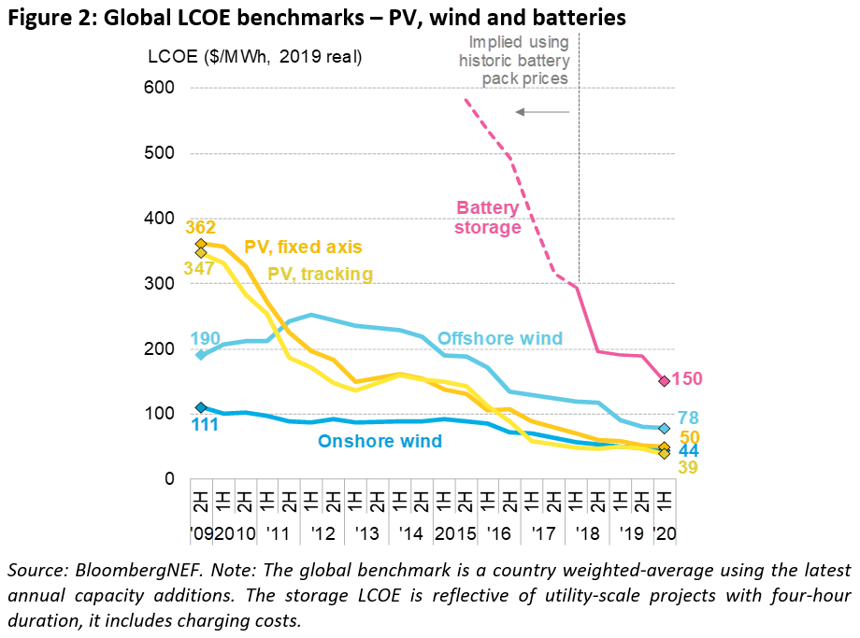
Cost evolution and learning rates for selected technologies
Source: https://about.bnef.com/blog/scale-up-of-solar-and-wind-puts-existing-coal-gas-at-risk/.
NB LCOE in Figure 2 stands for Levelised Cost of Electricity, which is a standard way of comparing the costs of different electricity technologies

Slide 12
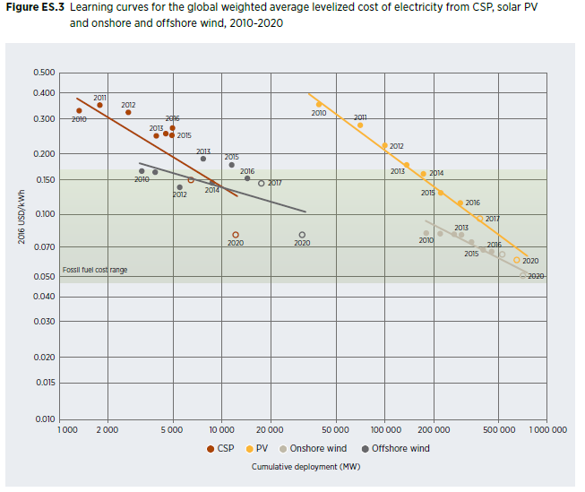
Cost evolution and learning rates for selected technologies (learning rates are percentage reduction from previous level after doubling of cumulative capacity)
Source: IRENA 2018 Renewable Power Generation Costs in 2017, https://www.irena.org/-/media/Files/IRENA/Agency/Publication/2018/Jan/IRENA_2017_Power_Costs_2018.pdf

Slide 13
What is Green Innovation?
The GIPC defines green innovation as the creation and adoption of new ideas, inventions, practices, processes, products and organisational forms that create value for society and the economy while giving better environmental outcomes and helping meet environmental objectives in line with science-based targets.

Slide 14
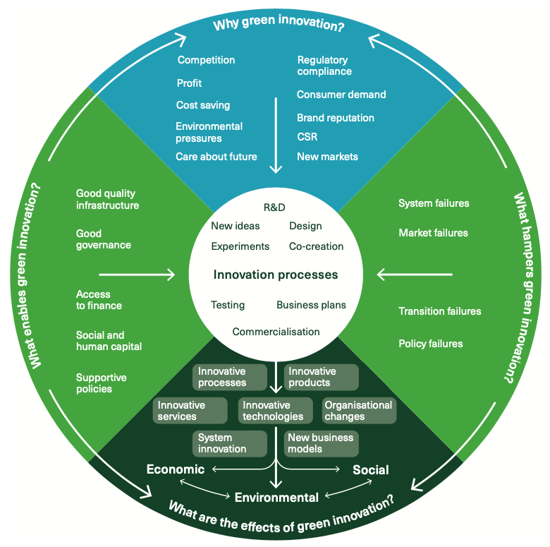
The Green Innovation Wheel

Slide 15
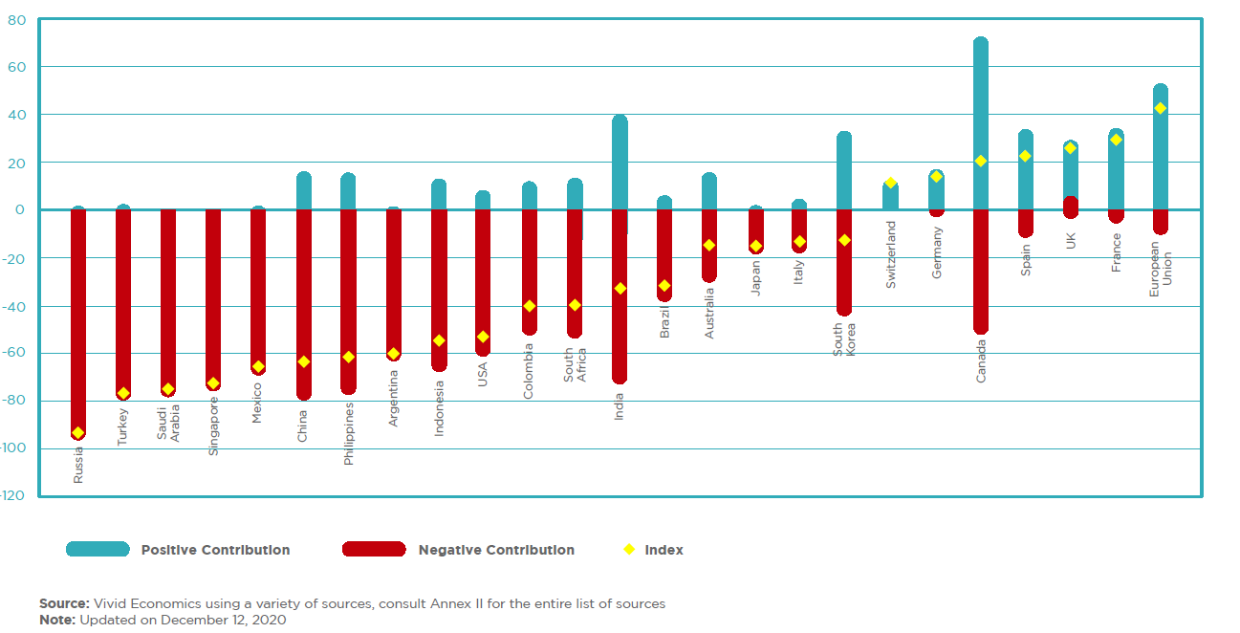
Post-Covid recovery spending: Greenness of Stimulus Index
Not looking good – effectively the last chance to change the trajectory

Slide 16
Conclusions
Building a nature-positive economy, including decarbonisation, is a massive challenge everywhere, but especially for MENA countries
Accelerated economic diversification is the only way that the region will maintain living standards and continue development towards the SDGs
The region’s solar resource is a huge opportunity to put the region’s economy on a different foundation
This will require a massive effort of innovation and a clear green orientation to post-Covid investment
The sooner the region – and the world – starts, the cheaper the transformation will be

Slide 17
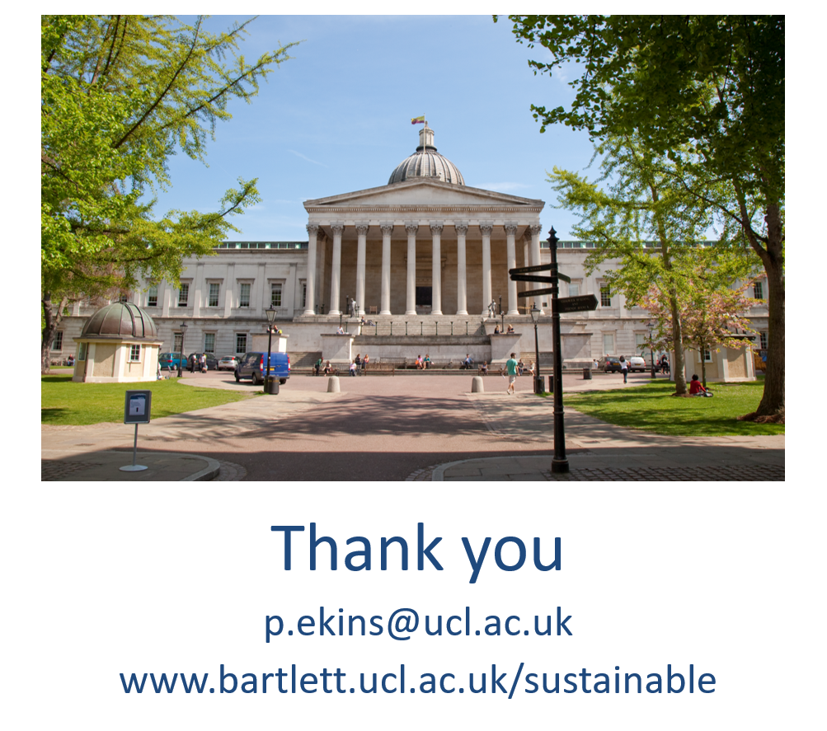

Slide 19
Appendix GEO slides

Slide 20
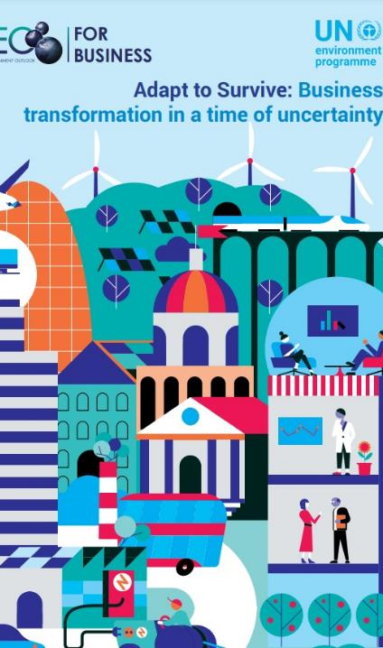
Adapt to Survive: Business transformation in a time of uncertainty
Coordinating Lead Authors: Derk Loorbach (DRIFT, Erasmus University Rotterdam), Ben Tuxworth (Anthesis Group)
Lead Authors: Denise Delaney (SustainAbility, an ERM group company), Theresia Ott (Rio Tinto), Aris Vrettos (Cambridge Institute for Sustainability Leadership)
Download Brief - > https://www.geo-business-report.org/

Slide 21
The scale of global environmental challenges is unprecedented
Climate change resulting in droughts, floods and devastating fires impacting commerce and daily life;
Environmentally unsustainable food production contributing to 70 per cent of global biodiversity loss;
Mounting urban waste with 7-10 billion tons generated globally each year and many cities lacking safe and environmentally-sound waste management systems;
Emerging zoonotic diseases like COVID-19 show the vulnerabilities of these systems and the need for strengthened global resilience and reduced inequalities including gender inequality.
Notes:
Business leaders know that economic activity depends on healthy people, resilient and equal societies, productive ecosystems and a stable climate, but business and society today face mounting challenges.
IPBES, IPCC and other reports have clearly articulated the unprecedented global environmental change already under way and how this has significant consequences for people
The economy is locked-in to a linear growth and development pattern still based on fossil fuels
It is for this reason that green growth and optimization are not enough to ensure the impacts of climate change are curbed and that biodiversity loss is halted, and we need to anticipate and rapidly shift to systemic to a state of transformational change.

Slide 22
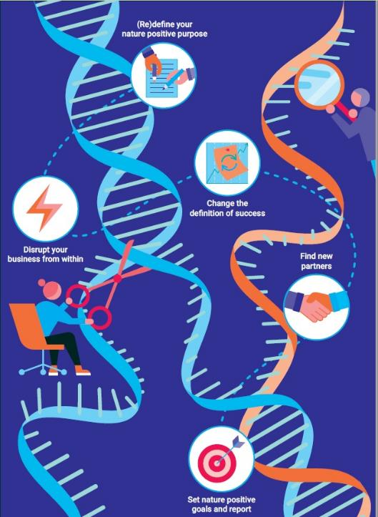
Business transformation is critical and possible
Half of all greenhouse gas emissions need to be eliminated globally by 2030 with near zero emissions achieved by 2050.
To end global hunger by 2050.
Waste streams like single-use plastics will need to be eliminated to restore the world’s oceans.
To support gender equality.
Notes:
Because of the scale of the challenge, time is of the essence, and business is fundamental to the solution. But business planning needs to align with a nature positive and gender equality mission that uses only renewable energy, restores biodiversity, aims for gender equal employment practices and moves towards a fully circular economy. Given the environmental challenges we face, these are the expected transformations that will need to happen in the next 30 years:
Greenhouse gas emissions - This implies at least an 80 per cent reduction in fossil fuel use by 2050.
End Global hunger - We must produce 50 per cent more food. Meanwhile, the environmental impact and biodiversity loss of that food production must decrease by two-thirds to protect human and planetary health.
Reduce Waste - Other pollution will need to be drastically reduced to protect nature and human health. This implies the creation of a near-fully-circular economy by 2050.
To support gender equality - in the circular economy and environmental governance, so as to fulfill by 2030 the goal of achieving full and productive employment and decent work for all women and men, including for young people and persons with disabilities

Slide 23
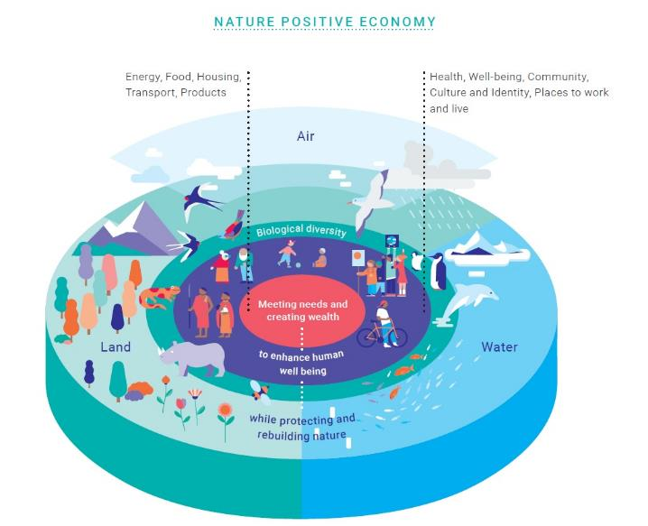
Notes:
An economy that is regenerative, collaborative and where growth is only valued where it contributes to social progress and environmental protection. Importantly, it is not dependent on fossil fuels§§§ for energy, on extracting and wasting resources or on exploiting people and communities to create value. It takes into account the gender and socio-economic factors of humanity

Slide 24
It is already happening
Companies such as;
General Motors aim to be carbon neutral by 2040
Amazon, has signed a 10-year corporate power purchase agreement with Ørsted, the world-leader in offshore wind.
Some companies such as IKEA have now committed to achieving full circularity by or before 2030
Countries:
UK Government issues first ever Sovereign Green Bond
China plans to raise minimum renewable power purchase to 40% by 2030.
Costa Rica, has shifted to 100 per cent renewables
European countries such as Austria, Germany and Portugal, as well as Chile, New Zealand and South Korea, have set targets to achieve net zero greenhouse gas emissions by 2050 or earlier
Countries as diverse as China, France, Singapore and Israel have set dates for some type of ban on petrol and diesel cars within the next two decades, with Norway committing to as early as 2025
Notes:
General Motors - a commitment to be carbon neutral by 2040 in operations and products. Aspires to eliminate tailpipe emissions from new light-duty vehicles by 2035.
This CPPA will contribute to Amazon’s target of being 100% renewable by 2030 as part of the company’s goal to reach net zero carbon emissions by 2040.
To help the UK meet its 2050 net zero target and other environmental objectives, the government will issue its first Sovereign Green Bond in 2021 subject to market conditions. These will help finance projects that will tackle climate change, finance much-needed infrastructure investment and create green jobs across the country.
China will force regional grid firms to buy at least 40% of power from non-fossil fuel sources by 2030 in order to meet the country’s climate targets
Costa Rica, the winner of UN Champion of the Earth, has shifted to 100 per cent renewables reforested the country and doubled GDP in the last 15 years

Slide 25
What can business do?
1. Disrupt from within
2. Set a nature positive purpose and strategy
3. Collective Action
4. Coherence of business targets and goals
5. There is no incentive like survival
6. The journey is as important as the destination
7. You are not alone
Notes:
1. Business leaders must transform themselves to align to this new reality. This means setting transformational goals to achieve success that includes the health and well-being of people and nature.
2. Business leaders need to change their core business assumptions to align with a nature positive approach. This includes asking whether the natural and social systems businesses depend on are healthy and resilient, while defining the business role in the broader global transformation.
3. Businesses can drive transformation from within, but it is easier when their neighbors and colleagues do so as well. This means engaging with policymakers, leaders from other business sectors and consumers.
4. Targets and goals must be aligned to the ambitious environmental goals we need to achieve, and they must be based on scientific evidence and indicators.
5. Smart businesses will profit from this transformative change by proactively changing the way they conduct business.
6. Transformational change will not happen overnight, but commitment, long-term vision, entrepreneurship and innovation will be key.
7. Transformation towards a Nature Positive Economy is already underway, through new technologies like solar and wind power, bio-based materials and electric mobility. These technologies are now mature and have pushed the global conversation from cleaning up environmental pollution to addressing the systemic risks of continuing on the path we are on and creating profit through transformative change.

